Slide 1


Mayo Clinic - Phase 3
Presented by: Devin Young, Olamikun Asorona, Daryl Coston

Slide 2
About Mayo Clinic
Mayo Clinic is the "largest integrated, not-for-profit medical group practice in the world" (About Us, n.d.).​
Top-ranked in more specialties than any other hospital and has been recognized as an Honor Roll member according to U.S. News & World Report's 2024-2025 "Best Hospitals" rankings (Top-ranked Hospital in the U.S. - About Us - Mayo Clinic, n.d.)​
Performs "basic, translational, clinical and epidemiological research at its campuses" (About Mayo Clinic Research, 2024)​

Slide 3
Mayo Clinic Locations & Network Type​
There are 4 buildings located in Arizona (Phoenix & Scottsdale), 9 buildings located in Florida (Jacksonville), more than 30 buildings located in Minnesota (Rochester), including the headquarters, and one building located in London, United Kingdom (U.S. And International Locations, n.d.) ​
With Mayo Clinic being geographically spread out, having approximately 65,000 employees and approximately caring for more than one million people per year (Mayo Clinic Proceedings, 2024), it is considered a wide area network​

Slide 4
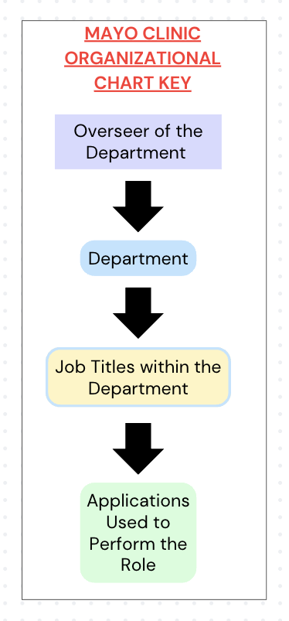
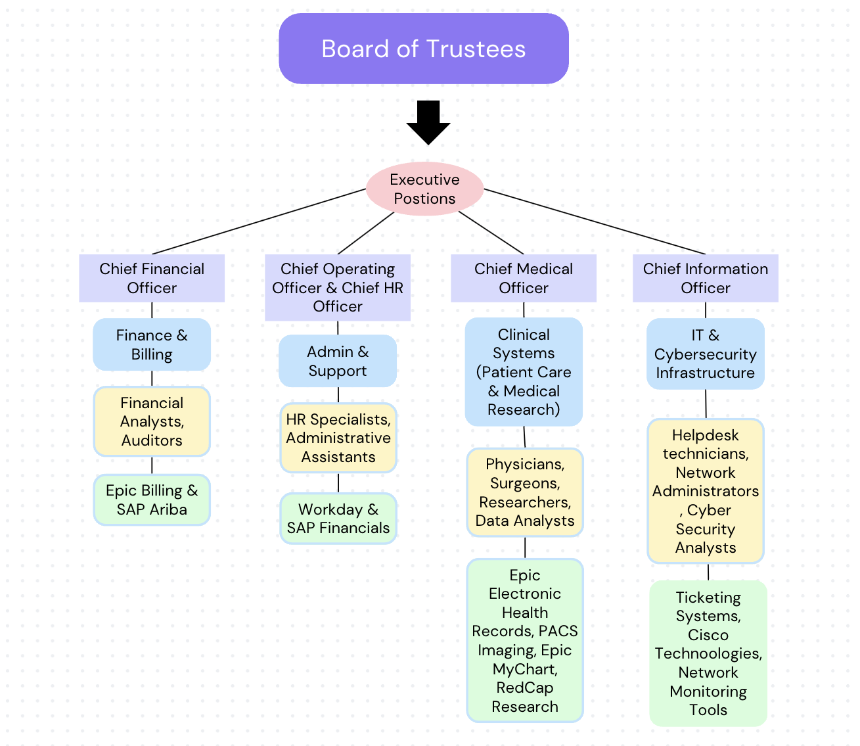
Mayo Clinic’s Organizational Chart

Slide 5
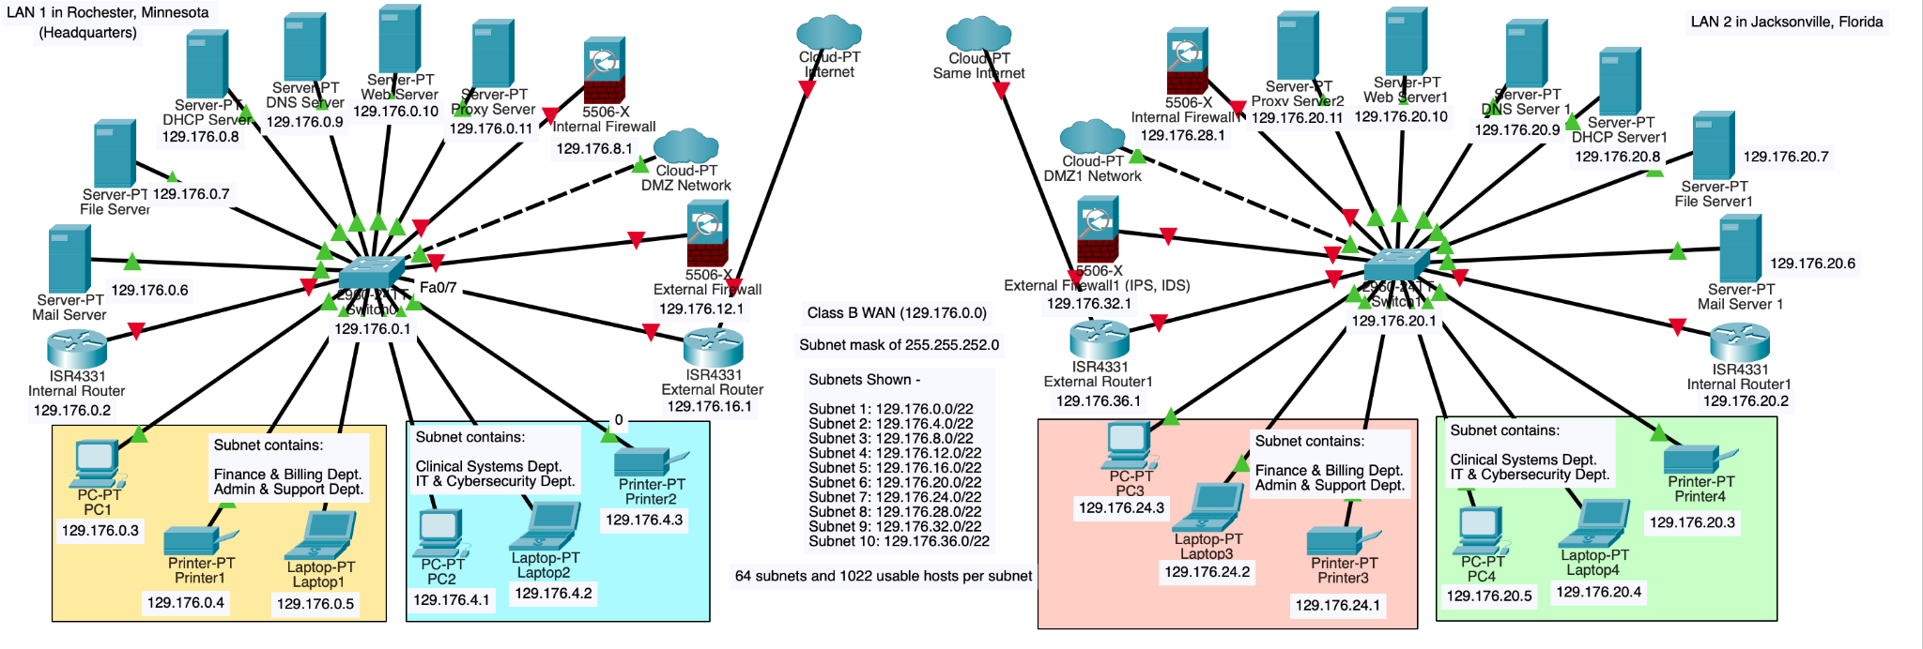
Network Diagram (Two Locations)

Slide 6
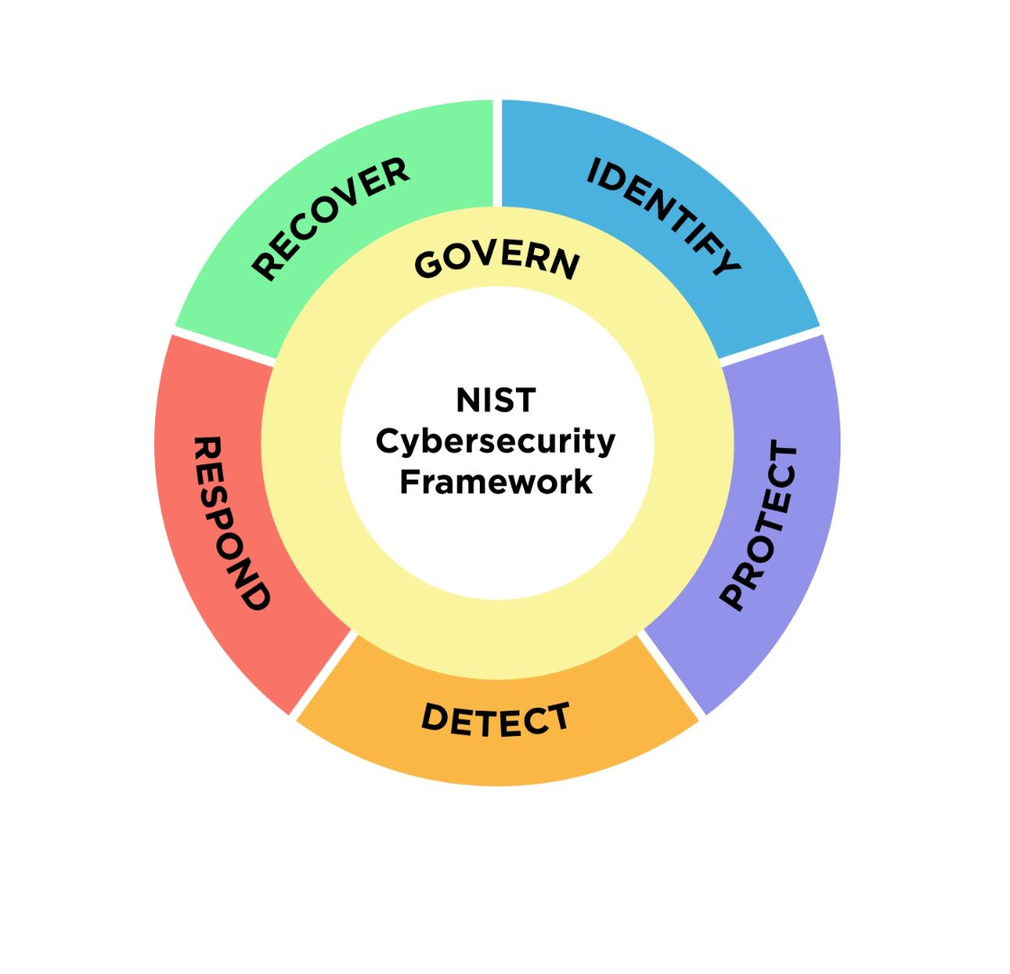
Core Functions of NIST Cybersecurity Framework
The NIST Cybersecurity Framework is centered around governing/managing cybersecurity practices, identifying cybersecurity risks and areas of improvements, protecting all assets, detecting cybersecurity attacks, responding to cybersecurity incidents, and recovering from cybersecurity incidents​

Slide 7
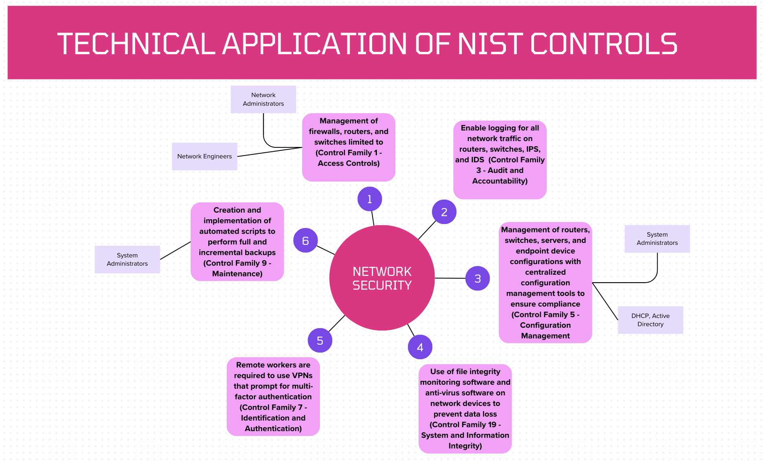

Slide 8
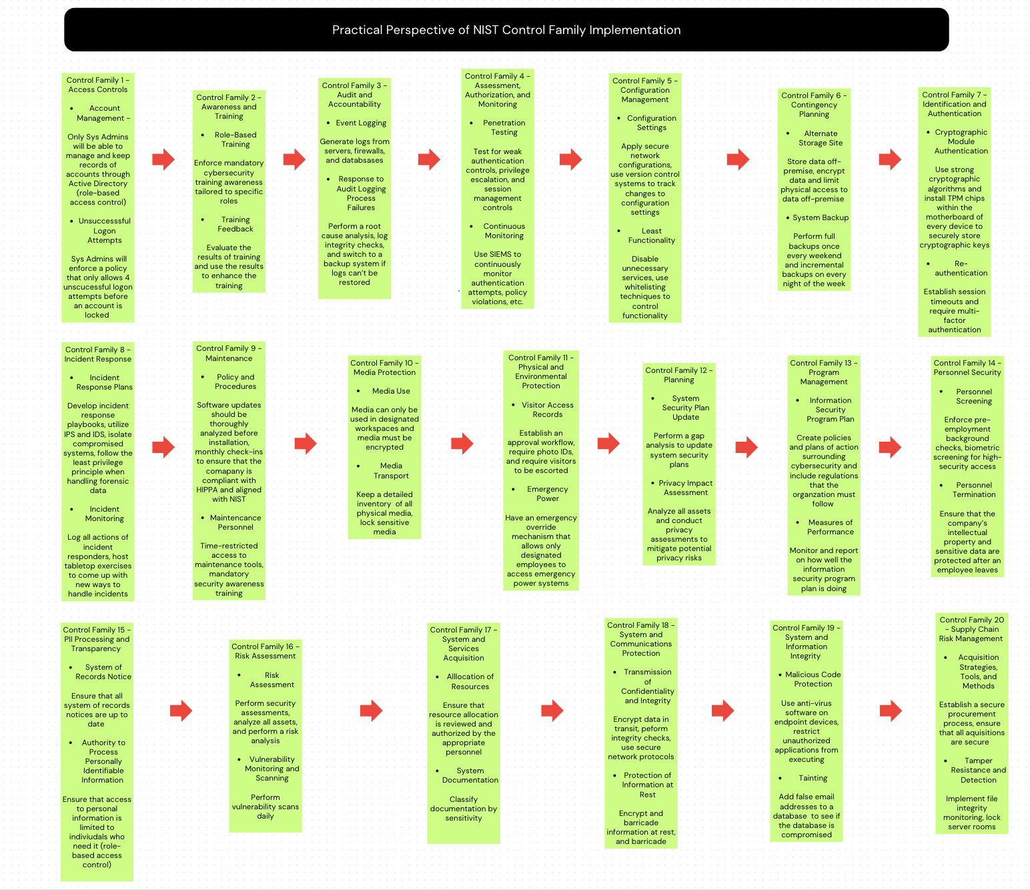

Slide 9
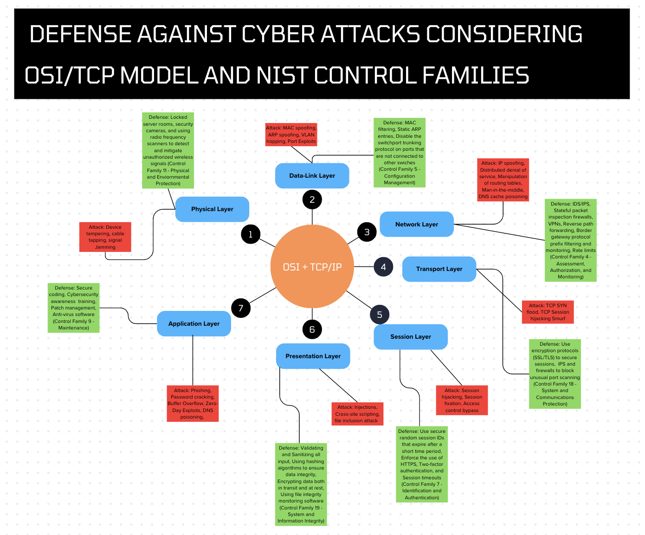

Slide 10
Additional Security Features & Business Continuity
All firewalls are stateful packet inspection firewalls, which means that they filter data packets based on the state and context of their connection, and don’t simply analyze individual packets
Use of endpoint detection and response software to monitor all endpoint devices for malware and signs of compromise
Full backups performed once on weekends and incremental backups performed every night of the week after-hours
Stored backups off-premise and encrypt them, and designating only authorized personnel to have access to them

Slide 11
References
About Mayo Clinic. Mayo Clinic Proceedings. (n.d.). ​
https://www.mayoclinicproceedings.org/content/aboutmayo ​
About Mayo Clinic Research. (2024). Mayo Clinic. Retrieved October 31, 2024, from ​
https://www.mayo.edu/research/about/overview ​
About us. (n.d.). Mayo Clinic. https://www.mayoclinic.org/about-mayo-clinic​
Health Insurance Portability and Accountability Act of 1996 | CMS. (n.d.). ​
https://www.cms.gov/about-cms/information-systems/privacy/health-insurance-portability-and-accountability-act-1996#:~:text=The%20Privacy%20Rule%20of%20the,and%20other%20personal%20health%20information. ​
​

Slide 12
References
NIST Cybersecurity Framework | NIST. (2024, September 27). NIST. ​
https://www.nist.gov/itl/smallbusinesscyber/nist-cybersecurity-framework-0 ​
Shriram Vasudevan. (2022, April 14). OSI layer and corresponding cyber attacks and threats [Video]. YouTube. ​
https://www.youtube.com/watch?v=FqP4QiyKh4M ​
Top-ranked hospital in the U.S. - About Us - Mayo Clinic. (n.d.). ​
https://www.mayoclinic.org/about-mayo-clinic/quality/top-ranked ​
U.S. and International Locations. (n.d.). Mayo Clinic. ​
https://www.mayoclinic.org/locations ​

